Slide 1


Blockchain-based eCommerce warranty system using NFTs
Team Name: Dev62
Institute Name: Jc Bose University of Science and Technology , YMCA , Fbd

Slide 2

Team members details
Team Name | Dev 62
Institute Name | Jc Bose University of Science and technology YMCA Faridabad
Team Members > | 1 (Leader) | 2 | 3
Name | Satvik | Vivek Aggarwal | Shreya Garg
Batch | 2019-2023 | 2019-2023 | 2019-2023

Slide 3
Deliverables/Expectations for Level 2 (Idea + Code Submission)
The solution should focus on:
The blockchain smart contract should allow users to prove ownership
Provide the purchasing history, warranty period, and other item information
The warranty card should include the item’s serial number and upon purchase be sent to the customer’s smartphone.
The NFTs should be decaying in nature, in that, after a certain period their use for the redemption of warranty benefits offered by the brand/retailer will expire
Bonus - GUI-based tool that doesn’t require knowledge of any Blockchain programming to use by Brands and Retailers.
Bonus - Usage of Soulbound NFTs
Bonus - Add any engagement/gamification construct to the loyalty program

Slide 4
Glossary
NFT : Non-fungible Token
IPFS : InterPlanetary File System
GUI : graphical user interface

Slide 5
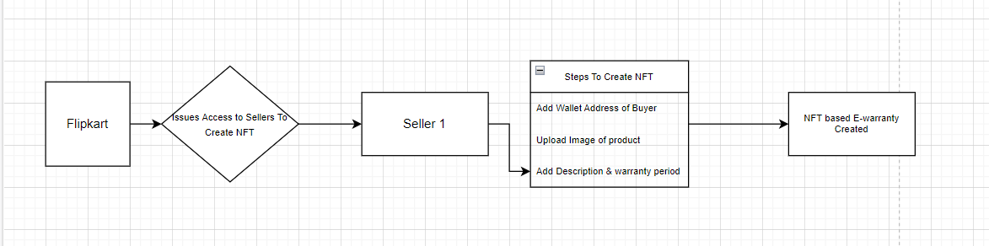
Solution statement/ Proposed approach
Solution : To provide the functionalities of Blockchain-based eCommerce warranty system using NFTs , we Team DEV62 proposes a solution where Flipkart can provide portal access to its sellers, where seller can easily create a NFT e-warranty card in 3 steps :
Provide wallet address of buyer ( Flipkart customer who is buying that product)
Upload image of product/ physical warranty card
Provide description and describe warranty period for that product
Now NFT for that product is created on rinkeby blockchain network and all details are stored related to that block on Ipfs
Customer can now easily check for their bought products and their associated NFT cards on profile section ( Order section in case of Flipkart)
On other hand our solution consist of An open portal page where any of the customer can enter their Product’s serial IDs and claim ownership of that product based on their wallet address and Block Details of that particular Product
Using this convenient GUI portal and Hosted Blockchain Network , Seller and Customers of Flipkart can Create NFT as well as Claim using NFT e-warranty cards, some other subproblems like decaying nature , resale and return are further discussed on next slides

Slide 6
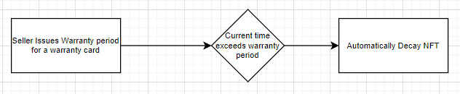
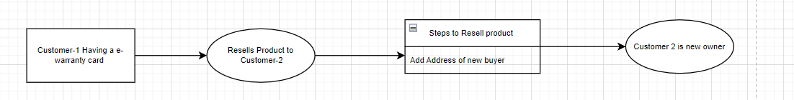
Subproblems
1) Decaying Nature of NFT e-warranty Card :
Problem : Digital version / NFT of issued product should decay after its warranty period
Solution : During the process of NFT Creation, Seller will be providing the warranty period for particular product
That warranty period is store along with description on blockchain network and will be used to automatically Decay/Burn NFT after warranty period ends
2) Resale Of Product :
Problem : If customer resell his/her product like Mobile phone to another person, what about e-NFT cards ?
Solution : warranty cards are transferable tokens hence can be easily transferred to another blockchain wallet making that person a new owner of that product
Whole timeline for that product starting from owner to latest owner will be described

Slide 7
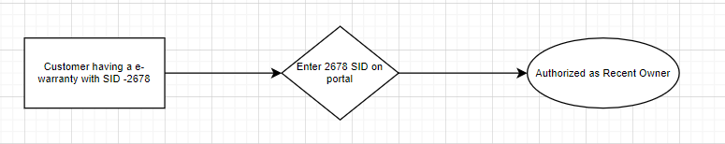
Subproblems
3) Claiming Ownership :
Problem : How will Customer Ensure that this NFT really belongs to Him/Her ?
Solution : An open portal page is provided where user can enter serial ID/ NFT Token ID and claim his/her ownership for that product
( User ‘s Wallet Address will be Matched with the recent Owner of that Card , If it matches then user will be owner)
4) Detailing of Product :
Problem : As this is a digital version of product , what details will this warranty Card contain ?
Solution : All the details will be stored along with the original image of product , details will include , SerialID of product , Name of product , Description of product , Warranty Period of product

Slide 8
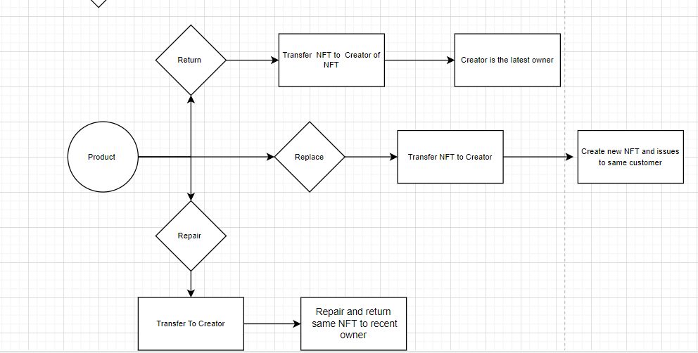
Subproblems
5) Return , Replace, Repair of product :
Problem : If customer wants to return , replace his/her product like Mobile Phone , what about e-NFT cards ?
Solution : as mentioned earlier, NFT tokens will be transferable , so in case of return or replace , the original e-warranty card will be transferred to its First owner ( i.e seller of that product / Creator of NFT) , hence now seller will the new owner
In Case of Repair , After repair , Seller can transfer NFT to its latest owner !
In this way using the timeline of a NFT , user can track repair and return records of that product

Slide 9
Use-cases
Flipkart on behalf of their sellers can issue customers their e-warrenty card in form of NFT
Customer can easily claim the ownership using NFT e- Warrenty card
Simple GUI portal for seller as well as cutomer to create NFT and claim ownership respectively
It will Act like a Digital Version of Your product , Containing Details and Image
Customer can Have track of Repairs or Resale of particular product
No other customer can have a duplicate warrenty card for same product thus can easily detect theft and misplace of particular product
Seller can now repair, return, replace the product on basis of this e-warrenty card
Customer can resale product by transferring the e-warrenty card to new person
E-warrenty card will contain all the details for the product including warrenty period and serial id
Once a card is issued it cannot be changed or modified thus ensuring proper decaying time for seller
Blockchain Network Ensures the transperancy to whole process of buying, selling , repair and reselling

Slide 10
Limitations
-> Currently All products are transferable , Some product Must be restricted to resell
-> This require a little prerequisite knowledge of Blockchain wallets to accept and transfer e-warranty
-> Extra Gas Fees Cost for Seller on Selling and Customer For Repair/Replace/Resell
-> Requires Time to Scale to large userbase
-> Blockchain have no space for errors , if any of the transfer contains wrong or incorrect address ,NFT cant be regained back

Slide 11
Future Scope
-> This Simple and efficient solution can be easily integrated with existing Flipkart’s Warranty System
-> This Solution will promote Virtual Buying and Selling of Products
-> This contract can be deployed on a network with lower transaction fees

Slide 12
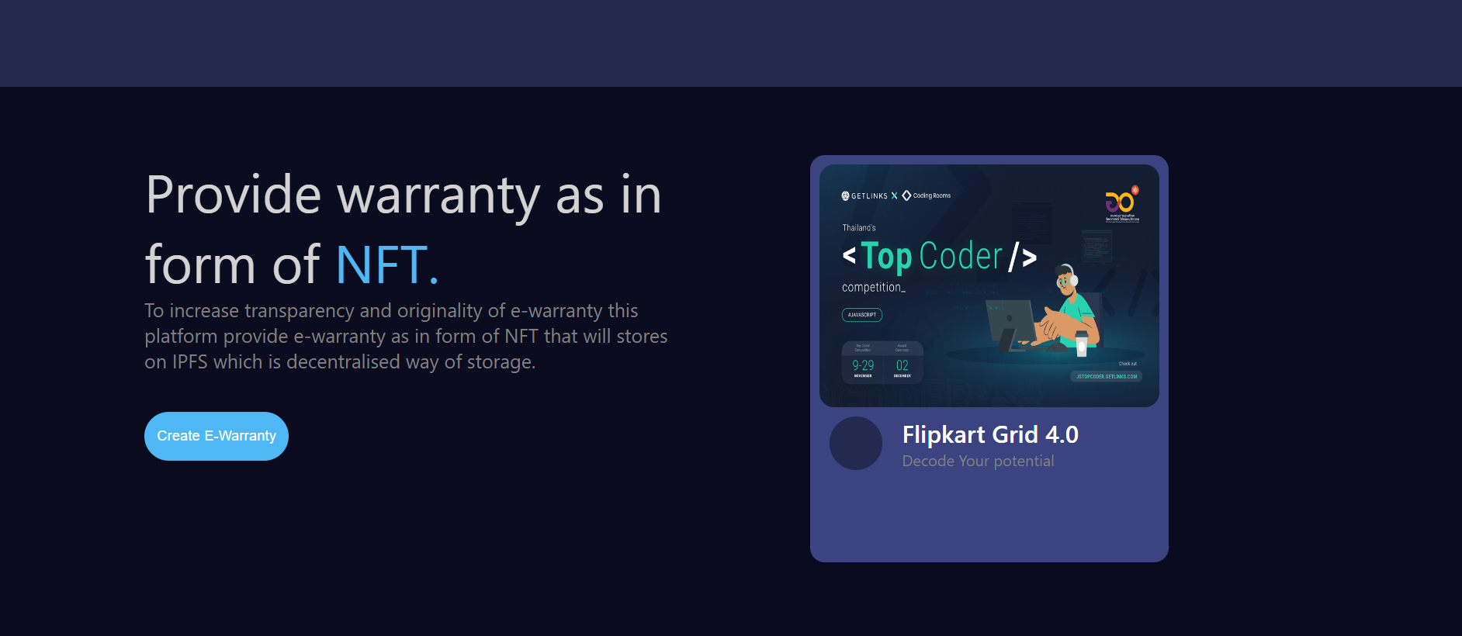
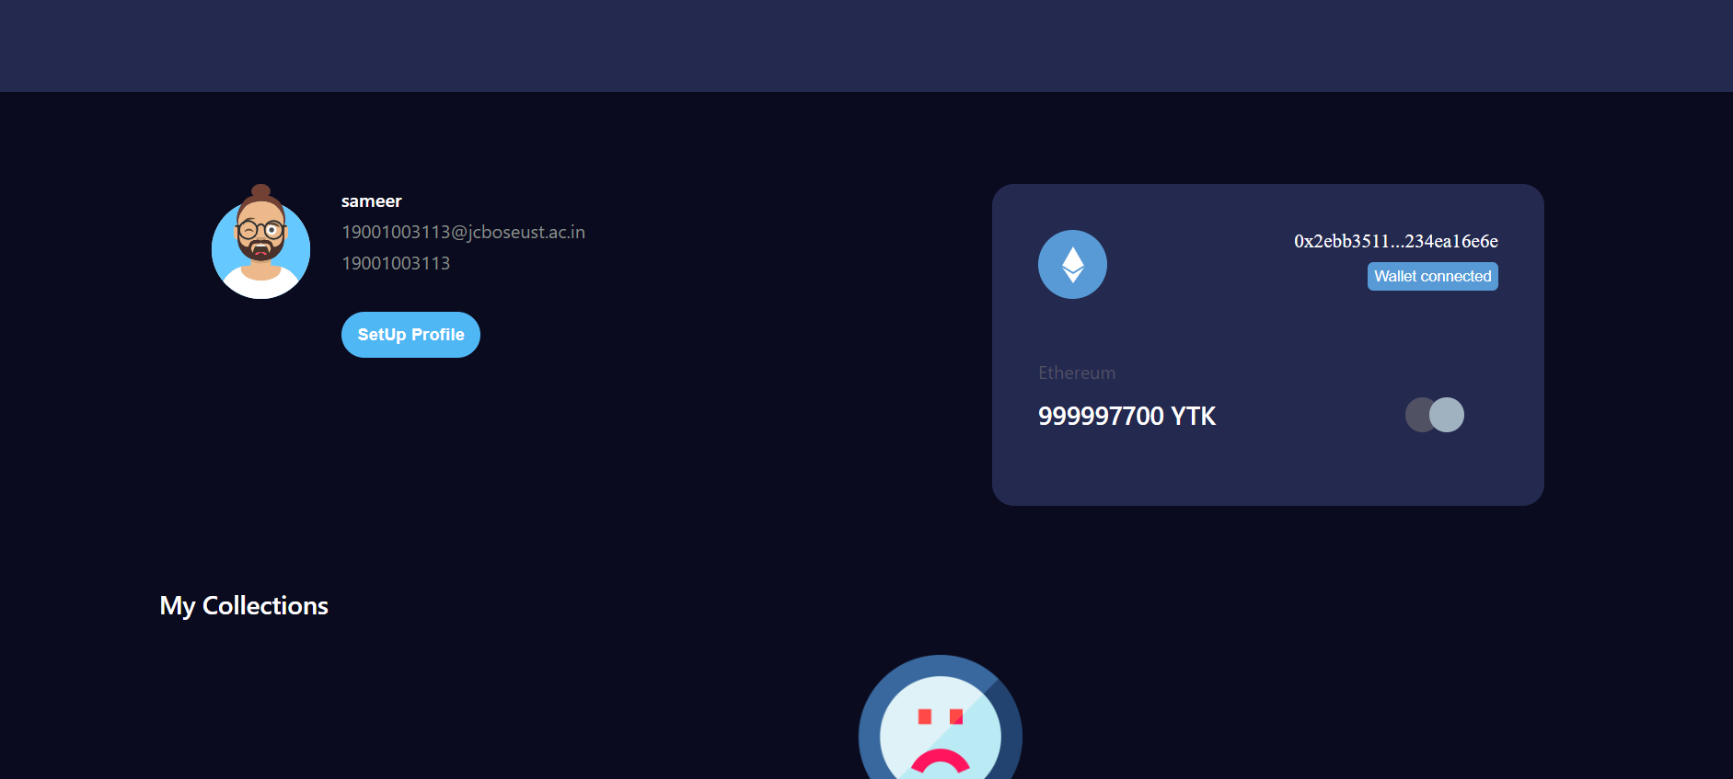
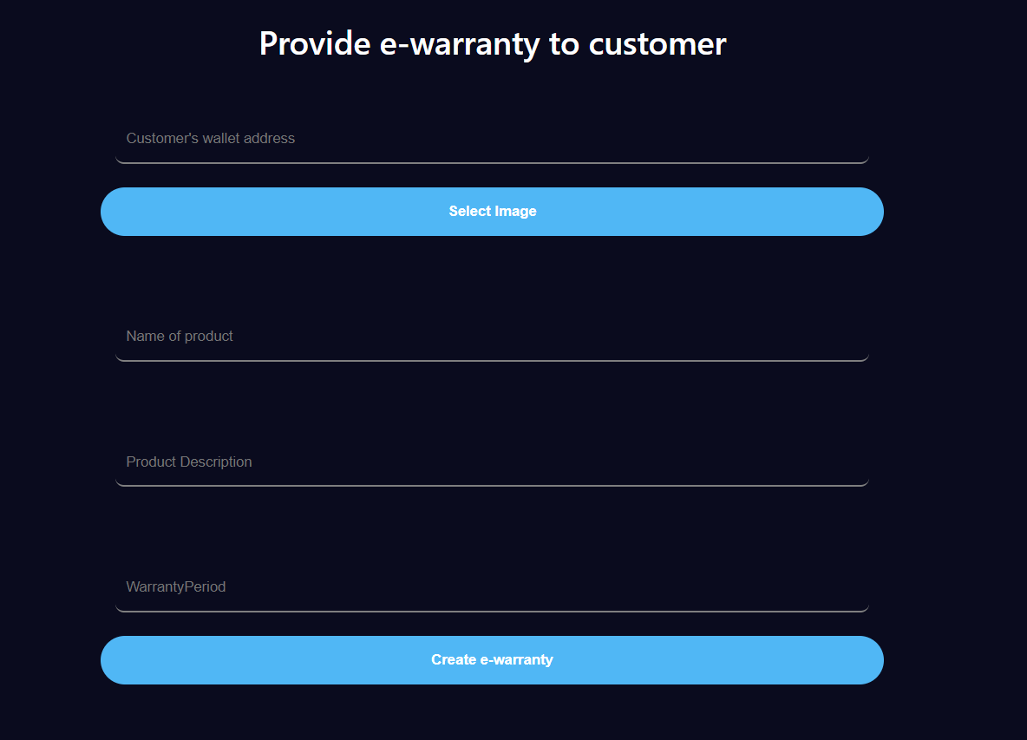
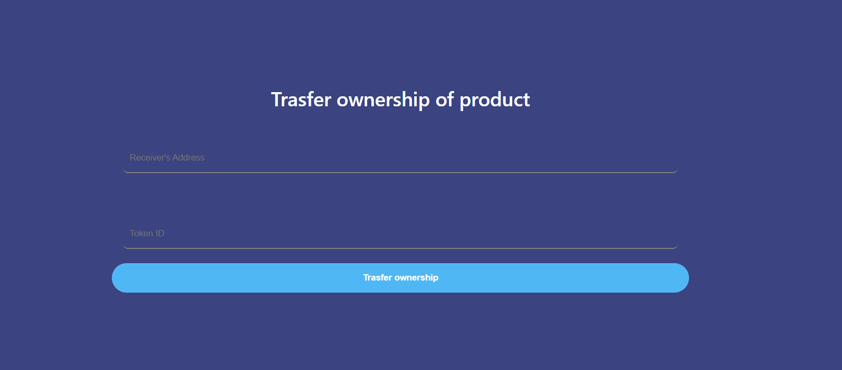
Snapshots

Slide 13
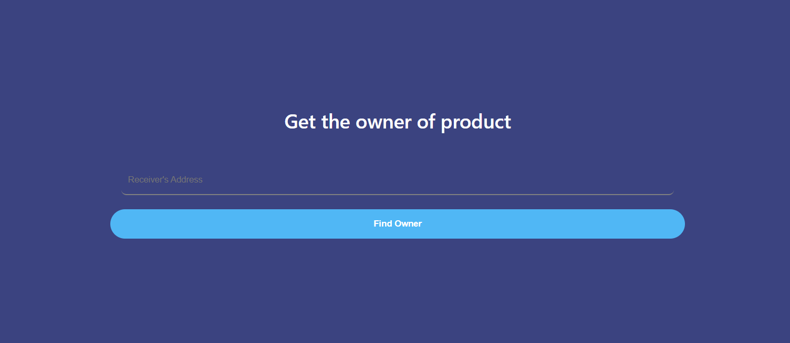
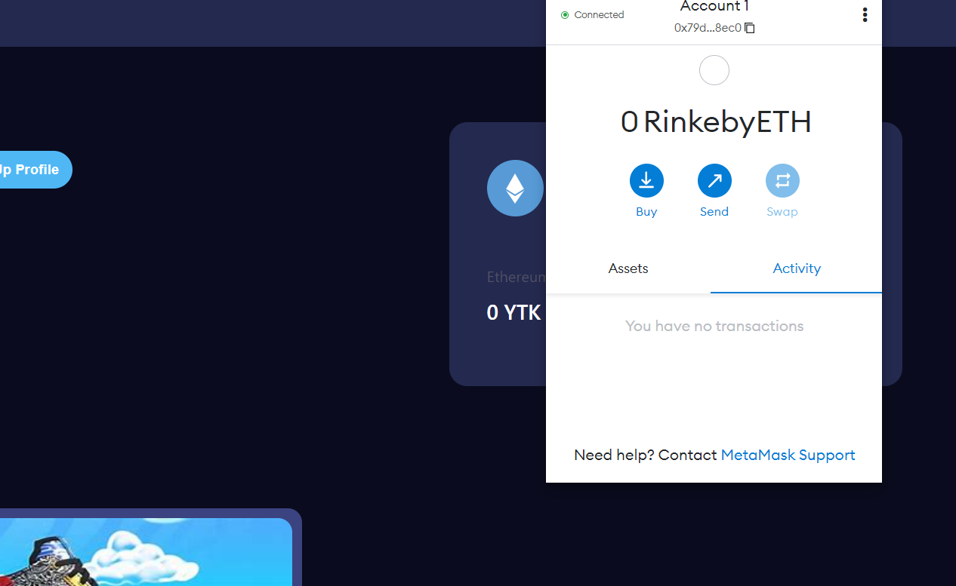
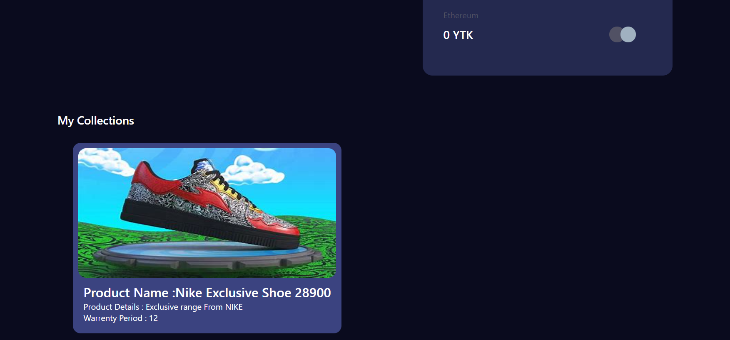
Snapshots

Slide 14
Links and Resources
As this solution uses metamask wallet and particular contract is deployed on network using a specific address , while using this project , we have to import admin account on metamask
Steps to have metamask :
Add metamask Extension
Go to Import Account
Make some new Account fot transfer purpose
Details of Admin Account on Metamask :
Wallet Address : 0x2ebb3511EAa61E93C5358B1C2914b3234eA16e6E
Private Key : 34b98faf9eedbc9e2593fd0b5e4b65a57cc57abdeab9623b5d71648c5c43b006
GITHUB LINK : codekarsatvik/flipkart-grid (github.com)
RECORDED VIDEO LINK : LOOM VIDEO
BASIC COMMANDS TO RUN PROJECT :
::: NPM INSTALL –force
::: NPM RUN START

